Slide 1
Pathfinding:
Search Space Representations
Dan Bader

Slide 2
Chapter written by Paul Tozour
Designed and developed a shared AI platform for Thief 3 and Deus Ex 2: Invisible War
Developed the combat AI systems for Microsoft's MechWarrior 4: Vengeance
Founding member of Gas Powered Games
Designed and programmed a real-time strategy game called WarBreeds
Has also written numerous AI articles for the Game Programming Gems and AI Game Programming Wisdom series

Slide 3
Performance and Memory Overhead
Pathfinding algorithm only half the picture
Underlying data structure is just as important
Comparable to using sort(), find(), copy() C++ Standard Template library functions with different container types (lists, vectors, etc.)‏
Different performance characteristics

Slide 4
Goal: Find representation that
Fits within a reasonable amount of memory
Gives us the fastest possible search time

Slide 5
Some properties of all representations
Fundamentally a Search Space can be viewed as a graph
  Has some atomic unit of navigation: node
  Some number of connections between nodes: edges
Large graphs take up lots of memory and slow performance (more nodes/edges cause larger search space)‏
Smaller simpler graphs leave smaller memory footprint, but run the risk of not accurately representing the game world (too simple)‏

Slide 6
Goal of Pathfinding algorithms
Optimal path = not always straight line
  Travel around swamp versus through it
“Least expensive” path
Trade off between simplicity and optimality (too simple a representation and pathfinding will be fast, but will not find very high quality path)‏

Slide 7
Capabilities of AI
Different characters have different movement capabilities and a good representation will take that into account
  Agents ask “Can I exist there?”
  Large monsters can’t move through narrow walkways

Slide 8
Capabilities of AI

Slide 9
Another Goal
Search Space generation should be automatic
  Generate from world’s raw geometry or from physics collision mesh
  Manual node placement must be done for all world pieces. Takes time and effort

Slide 10
Scripted AI Paths
Search Space representation is different than patrol path creation tool
Designers want predefined patrol paths, so they script them
  Works well only in predefined sequences
  Not good for interactive behavior (i.e. combat, area-searching)‏
Keep scripted patrol sequences separate from search space

Slide 11
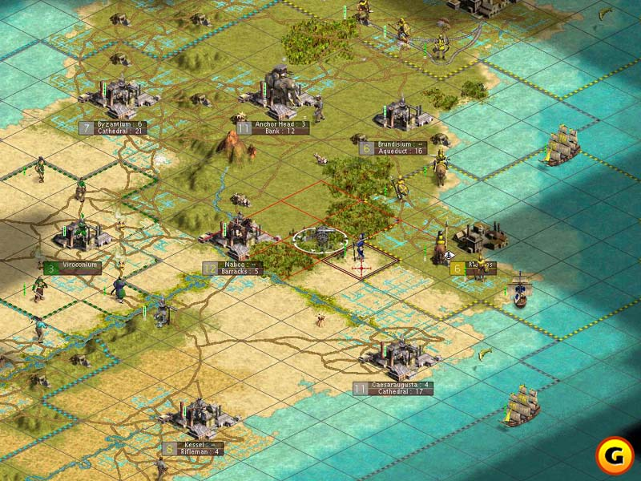
Regular Grids

Slide 12
Regular Grids
Won’t work for 3D game worlds without some modification
Mostly used in strategy games (typically with a top-down perspective)
Civilization 3 displays only four sides to each cell, but actually can move in 8 directions (along the diagonals)‏
Disadvantage: High resolution grids have large memory footprint
Advantage: Provide random access look-up

Slide 13
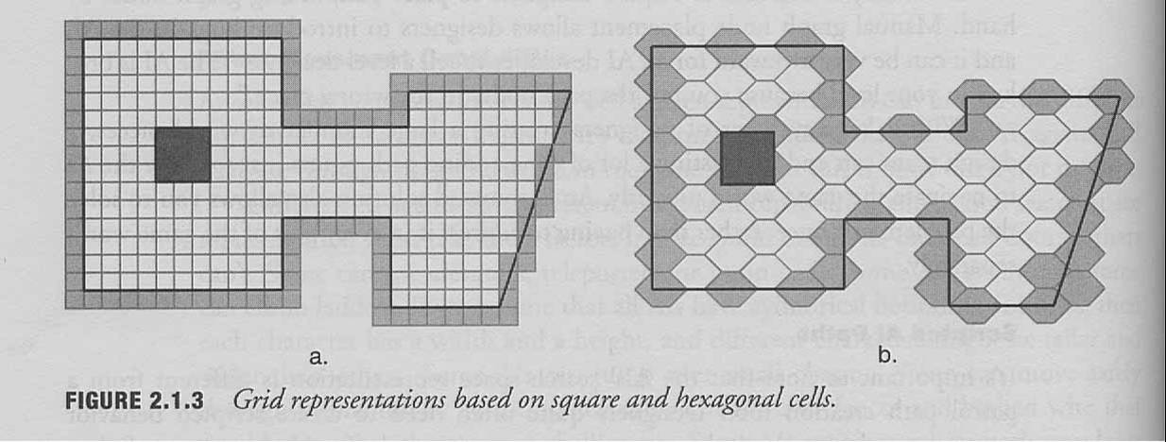
Regular Grids

Slide 14
Grids and Movement
Moving in only 4 cardinal directions gives you unattractive angular paths

Slide 15
Grids and Movement
Add in the diagonals and you improve the movement somewhat

Slide 16
An Optimization
String-pulling or Line-of-sight testing can be used to improve this further
Delete any point P_{n} from path when it is possible to get from P_{n-1} to P_{n+1} directly
Don’t need to travel through node centers

Slide 17
Another Optimization
Use Catmull-Rom splines to create a smooth curved path

Slide 18
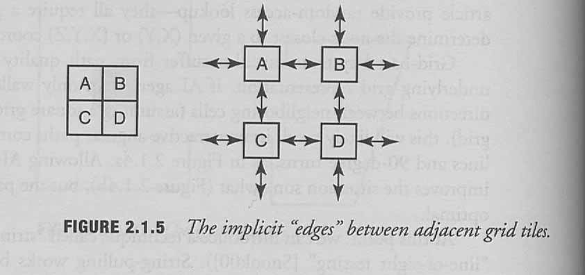
Graphs
The rest of the search space representations are graphs
You can think of grids as graphs
  Could be useful to have directed graphs (cliffs)‏

Slide 19
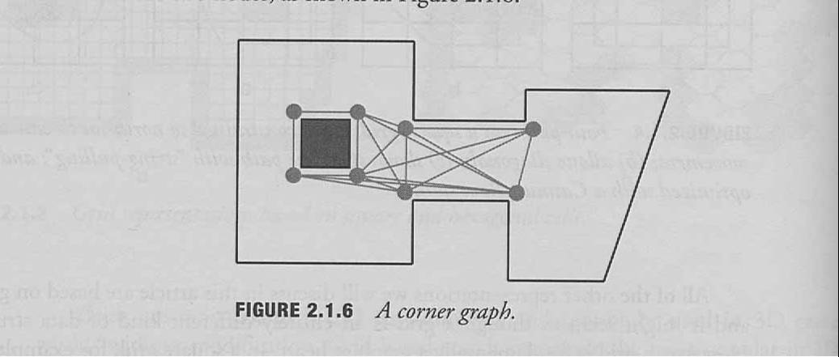
Corner graphs
Place waypoints on the corners of obstacles
Place edges between nodes where a character could walk in a straight line between them

Slide 20
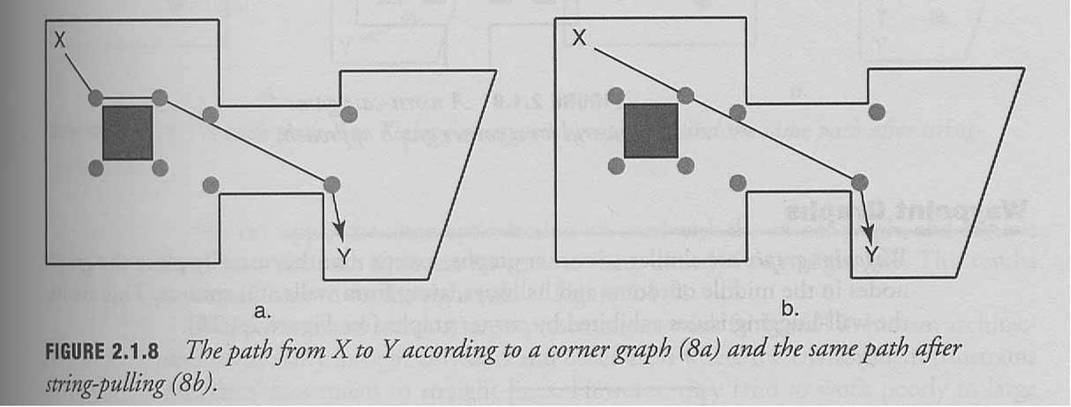
Corner Graphs
Sub-optimal paths
AI agents appear to be “on rails”

Slide 21
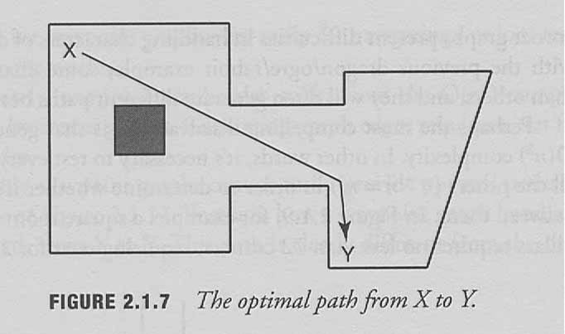
Corner Graphs and String-pulling
Can get close to the optimal path in some cases with String-pulling
Requires expensive line-testing
String-pulling

Slide 22
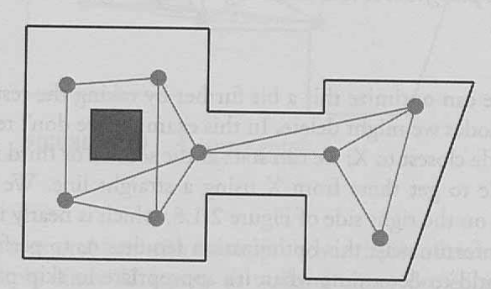
Waypoint Graphs
Work well with 3D games and tight spaces
Similar to Corner Graphs
  Except nodes are further from walls and obstacles
  Avoids wall-hugging issues

Slide 23
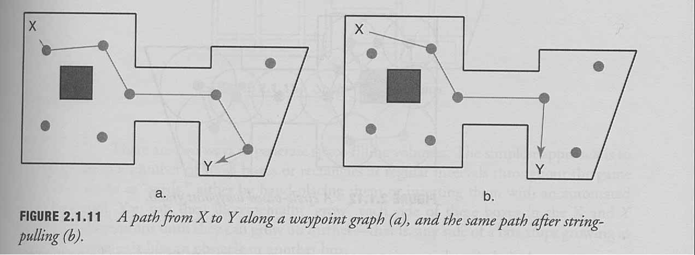
Waypoint Graphs
Cannot always find optimal path easily, even with string-pulling techniques

Slide 24
Circle-based Waypoint Graphs
Same as waypoint graphs
  Except add a radius around each node indicating open space
Adds a little more information to each node
Edges exist only between nodes whose circles overlap
Several games use a hybrid of Circle-based waypoint graphs and regular waypoint graphs, using Circle-based for outdoor open terrain and regular for indoor environments

Slide 25
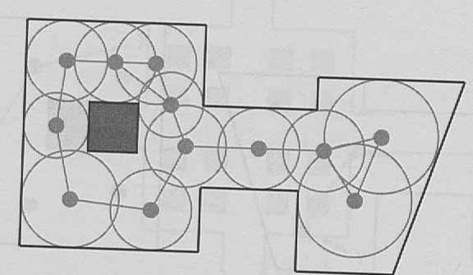
Circular Waypoint Graphs
Good in open terrain
Not good in angular game worlds

Slide 26
Circular Waypoint Graphs
Good in open terrain
Not good in angular game worlds
Y

Slide 27
Space-Filling Volumes
Similar to Circle based approach, but use rectangles instead of circles
Work better than circle based in angular environments, but might not be able to completely fill all game worlds

Slide 28
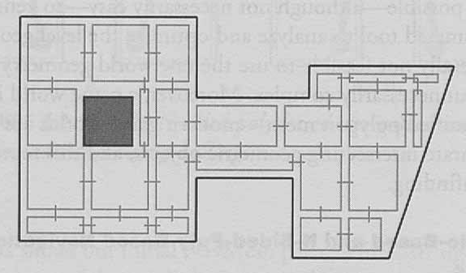
Space-filled Volumes
Can’t Get here

Slide 29
Navigation Meshes
Handles indoor and outdoor environments equally well
Cover walkable surfaces with convex polygons
Requires storage of large number of polygons, especially in large worlds or geometrically complex areas
Used in Thief 3 and Deus Ex 2

Slide 30
NavMesh
Polygons must be convex to guarantee that an agent can walk from any point within a polygon to any other point within that same polygon
It is possible to generate NavMesh with automated tool (was done in Thief 3 and Deus Ex 2) but difficult

Slide 31
2 types of NavMeshs
Triangle based
  All polygons must be triangles
  When done correctly, will not hug walls too tightly
N-Sided-Poly-based
  Can have any number of sides, but must remain convex
  Can usually represent a search space more simply than triangle based (smaller memory footprint)‏
  Can lead to paths that hug walls too tightly

Slide 32
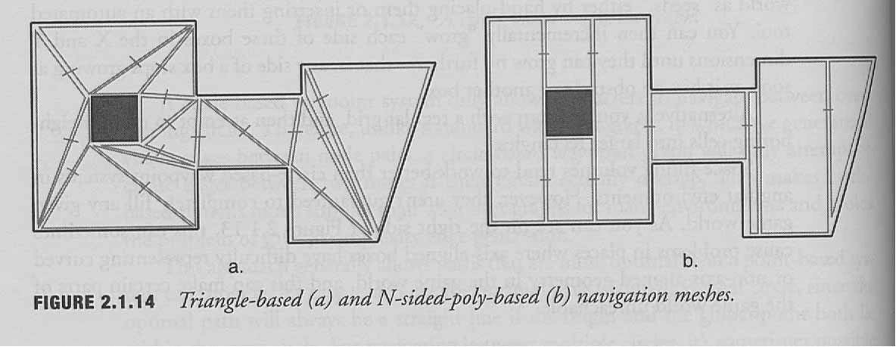
2 types of NavMeshs

Slide 33
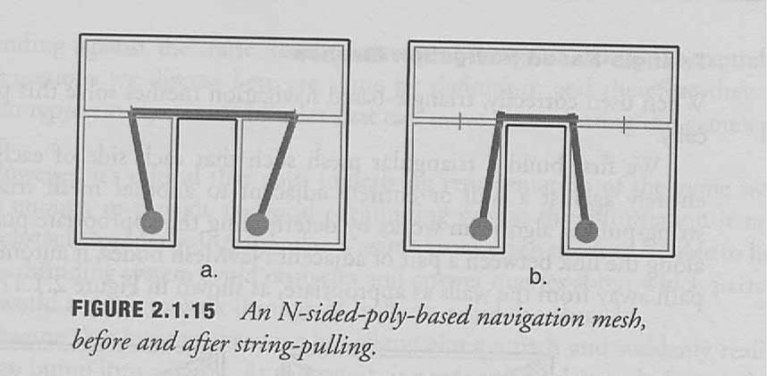
N-Sided-Poly-Based
Can address this problem with post-processing

Slide 34
Interacting with local pathfinding
Pathfinding algorithm must be able to deal with dynamic objects (things player can move)‏
Can use simple object avoidance systems, but can break down in worlds with lots of dynamic objects

Slide 35
Interacting with local pathfinding
Search Space is static, so it can’t really deal with dynamic objects
Should design it to give some information to pathfinding algorithm that will help
“Can I go this way instead?” – search space should be able to answer this

Slide 36
Conclusion
There is no right or wrong way to design search space representations
  Should depend on world layout, your AI system and pathfinding algorithm, and also memory and performance criteria
  Understand benefits and drawbacks and make the best choice based on that

Slide 37
Paul Tozour
“The system I designed for Thief 3 and Deus Ex 2 stored enough data in the NavMesh that units could create paths appropriate to their individual capabilities. A very tall unit would be able to query each node/polygon of the NavMesh to know that it couldn't fit through a crawlshaft. A fat NPC would be able to query the width of a doorway and know that it had to go another way. A character with very large, flat feet would know that it can't go up tall stairs or on steeply sloped surfaces. And so on.
The key is, if you represent the data in the right way, you can query it in your A* pathfinder to make sure that a given NPC will only create a path that it knows matches its particular movement/steering capabilities.”

Slide 38
References
IGDA Forum
Gamespot review
Paul Tozour Bio
AI Game Programming Wisdom 2, Chapter 2.1

